Slide 1
Harmful ingredients and added sugars: how common are they?
Fouad Yared

Slide 2
Questions to answer
Harmful ingredients
1) What harmful ingredients should I watch out for?
2) What's the relationship between the number of ingredients and the number of harmful ingredients?
3) Do certain foods have more harmful ingredients than others? What about added sugars?
Environmental Working Group's food scores
1) What factors are considered in creating the score?
2) What does the overall distribution look like?
3) What are the scores by category?
4) Is there variation within a category?

Slide 3
Data source
46,000 food records scraped from ewg.org
Scores range from 1 (best) to 10 (worst)
3 elements make up the composite score:
Nutrition (from the nutrients label)
Ingredients (pesticides, hormones, additives, etc)
Processing (how much has a food been processed)
Source: Environmental Working Group (EWG)
Group 1: unprocessed and
minimally processed.
Examples: vegetables, fruits,
nuts, eggs, meat, milk
Group 3: processed
foods with few ingredients.
Examples: canned fish,
salted nuts, sourdough bread
Group 2: processed
supplemental ingredients.
Examples: olive oil, salt,
honey, sugar, dried herbs.
Group 4: highly processed
with many ingredients.
Examples: candy, instant
soups, ice cream, cereals,
soda and hot dogs
Source: Washington Post

Slide 4
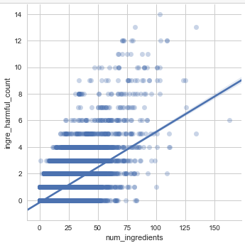
Comparing ingredients to harmful ingredients
As the number of ingredients increases,
the number of harmful ingredients also increases.

Slide 5
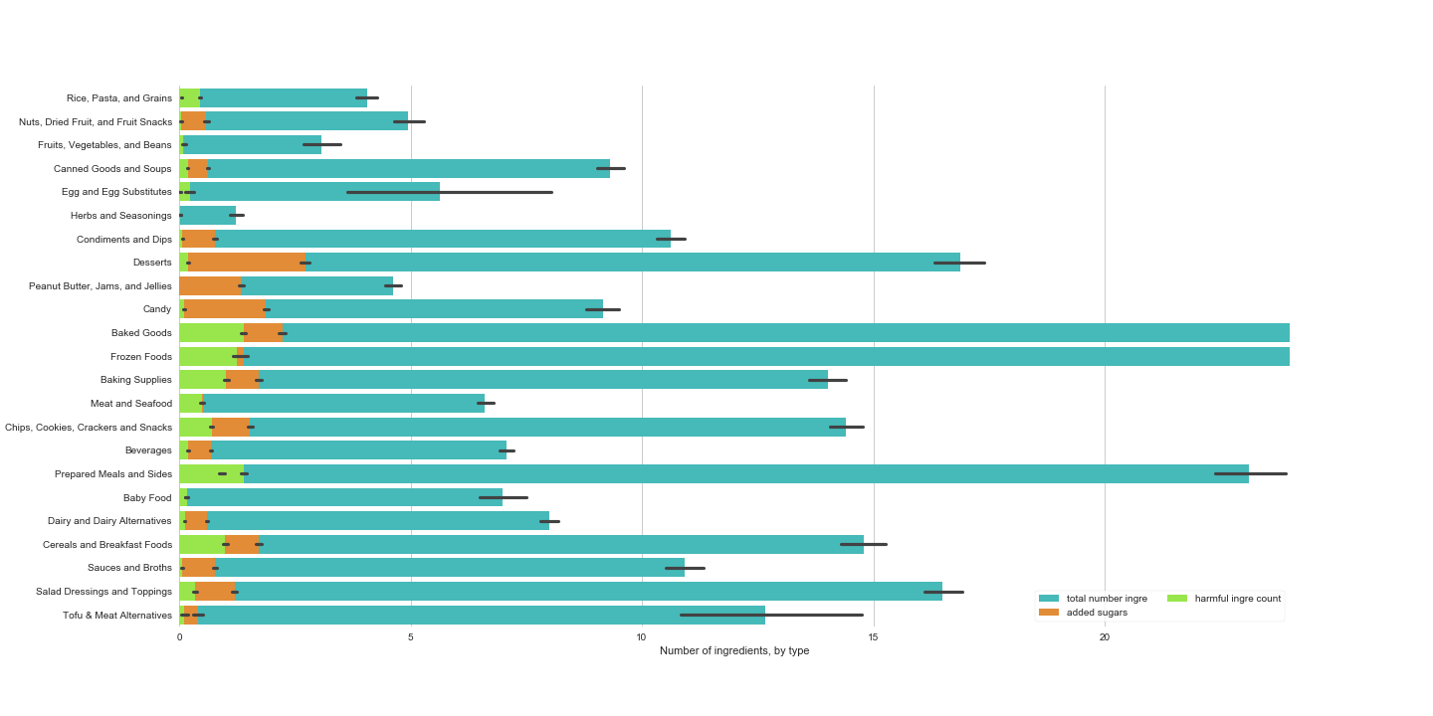
Number of total ingredients, harmful ingredients, & added sugar
On average, desserts, candy, baked goods, and baking supplies have the greatest total of added
harmful ingredients and added sugars.
Baked goods, frozen foods, and prepared meals have the most ingredients.

Slide 6
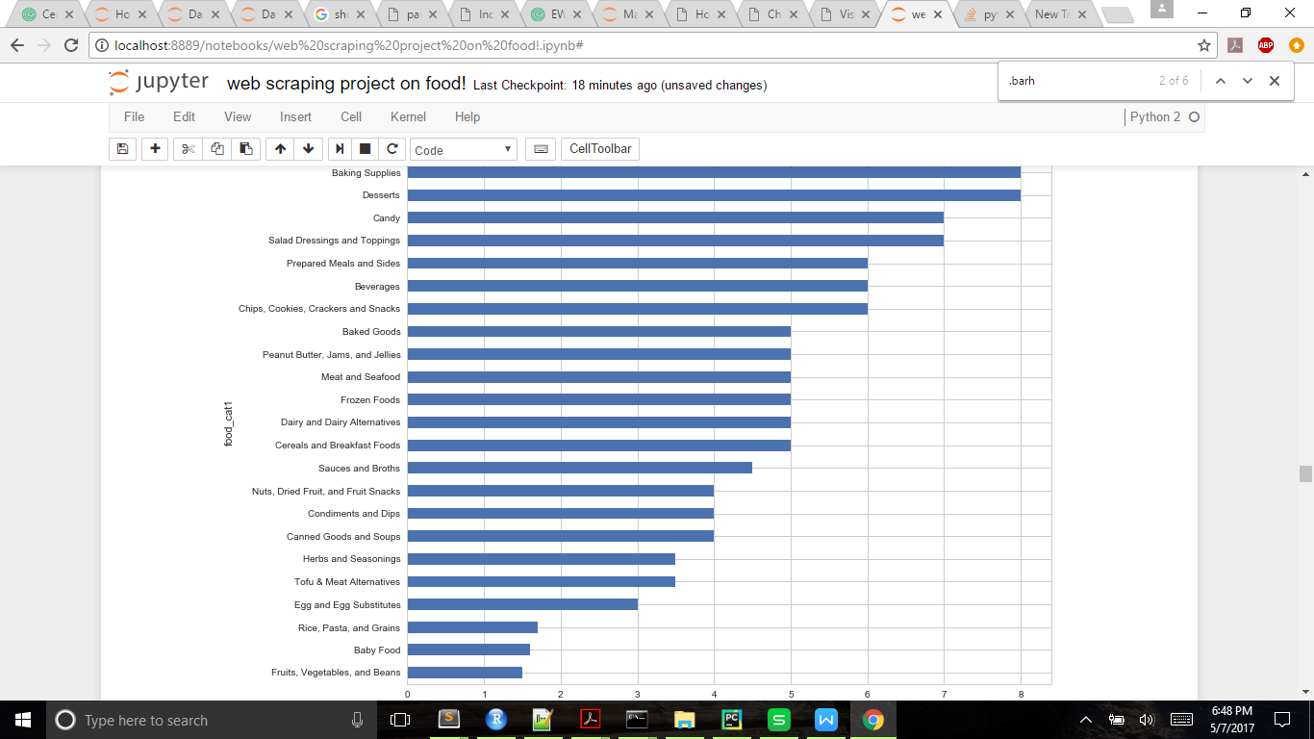
Comparing median scores by category
Scores range from 1 to 10.
The higher the score, the more an item
should be avoided or used in moderation.
Foods with the worst scores have the
highest number of added sugars and
harmful ingredients.
(Look for the blue arrows.)
Foods with the best scores are fruits, vegetables and beans; baby food; and rice, pasta, and grains.

Slide 7
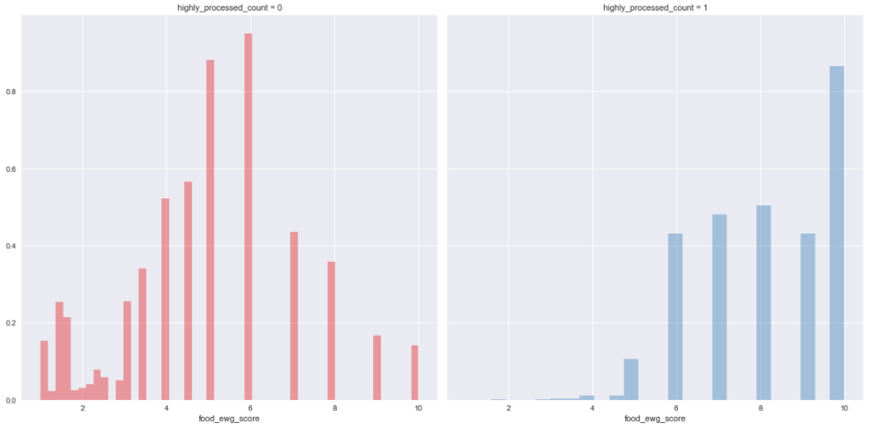
Score distribution for highly processed food
The scores of minimally
or moderately processed
foods follow a normal
distribution.
Highly processed foods have a limited range of scores and most often have a score of 10.

Slide 8
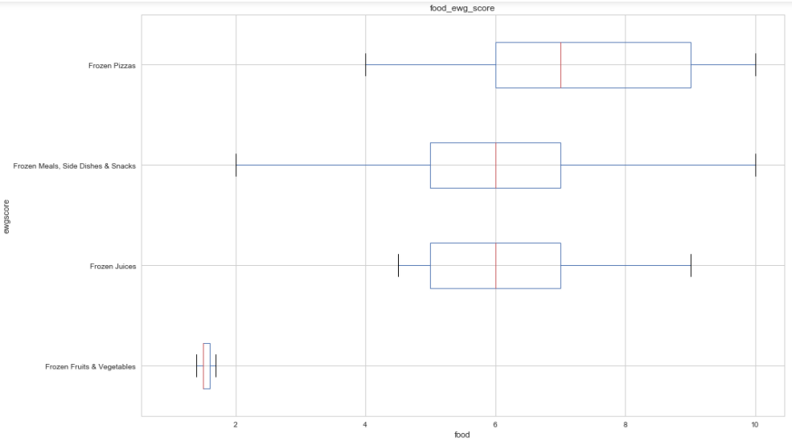
Comparing scores of Frozen Food subcategories

Slide 9
Summary
When deciding on what to buy, choose something with less ingredients.
Examples of foods that should be limited are desserts, candy, and
baked goods because they are high in added sugars and harmful ingredients.
It's best to limit the number of highly processed foods one eats,
which can be done by looking at the EWG scores (at ewg.org)
or by searching the ingredients label for the harmful ingredients.
There is wide variation wtihin groups.
Frozen fruits and vegetables are much better for you than frozen pizzas or meals.

Slide 10
Next steps
What foods do people tend to buy? Why?
Do people gravitate towards relatively healthy and tasty foods?
Is conveinence a large factor in what a person purchase?
How to get the most nutrients out of one's food
Frozen fruits and vegetables have more nutrients than fresh ones
Steaming vegetables provides more nutrients
Comparing the time it takes to prepare a certain food/meal

